Slide 1
Introduction into PharmaPendium’s DDI risk calculator
Predicting drug-drug interaction risk with PharmaPendium
Marnix Wieffer, Senior marketing manager
Notes:
Hello everybody and welcome to this general Drug-drug interaction introduction video

Slide 2

Learning objective
Mechanistic vs static modelling
Victim and perpetrator drugs
FDA guidance and impact
DDI risk calculator workflow and model
At the end of this video you should have a high level understanding of the impact and underlying mechanism of DDIs
This provides the foundation for the follow-up training video’s
Sherry Winter, PhD
product manager
Notes:
In this video, DDI product manger Sherry Winter, will discuss

Slide 3
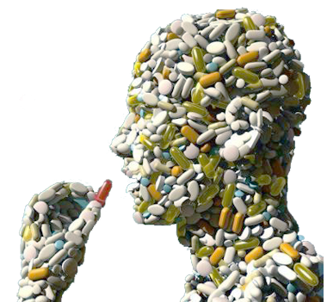
Early and ongoing assessment of Drug-Drug Interactions is critical
Drug-drug interactions (DDIs) can lead to severe side effects and have resulted in refusal of approval, severe prescribing restrictions, withdrawal of drugs from the market and, in extreme cases, have caused deaths
According to the FDA, DDI-related adverse drug reactions are on the rise:
  More drugs — and many more combinations of drugs — are being used to treat patients than ever before.
    Between 1995 and 2010, the proportion of adults dispensed ≥5 drugs doubled to 20.8%, and the proportion dispensed ≥10 tripled to 5.8%.¹
  The rate of ADRs increases exponentially after a patient is on 4 or more medications
    13% of adults experienced potentially serious drug-drug interactions in 2010, correlating with the increase in polypharmacy¹
¹ Guthrie et al. BMC Medicine (2015) 13:74
Notes:
There is a significant cost to drug drug interactions when it comes to patient safety but also when it comes to the successful commercialisation and use of a drug
In an area of increasing polypharmacy, when more and more people are taking drugs, it becomes increasingly critical to accurately predict potential interactions and to assess the risk of DDIs during development to make decisions on which drugs to progress through development and to inform risk mitigation strategies

Slide 4
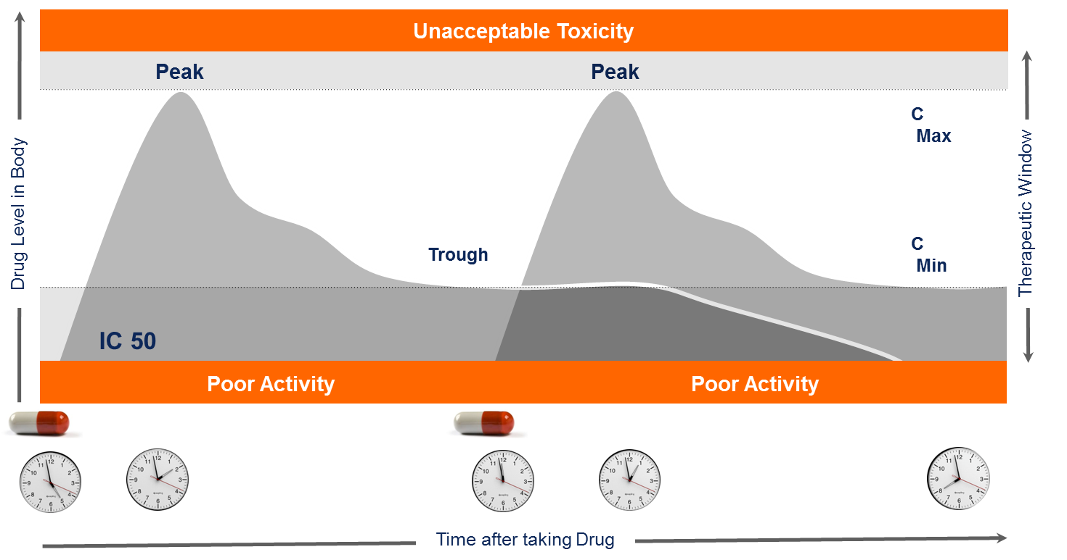
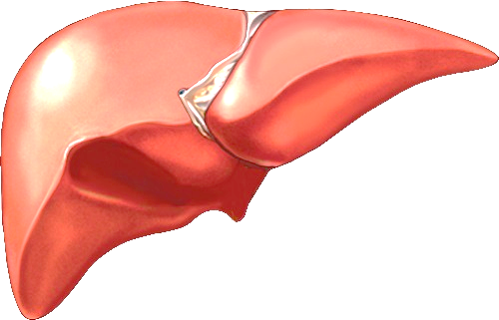
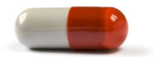
Drug-drug interactions can increase toxicity or reduce clinical efficacy
A major mechanism of drug metabolism (accounting for ~75%) is via P450 CYP enzymes in the liver.
Measured by AUC (area under the curve), which increases/decreases
P450
CYP
Metabolite
Drug-drug interactions may result when a concomitant drug* inhibits or induces the CYP-mediated metabolism of a second drug
E.g., Drug A is administered orally and metabolised by CYP3A
Dosage is timed so that plasma concentration levels remain high enough to maximize efficacy and low enough to avoid toxicity.
Concomitant drug = two or more drugs are taken at (almost) the same time
Notes:
There are a number of reasons for drug interactions, but when it comes to metabolism-based interactions, they may occur when a drug taken at the same time (the concomitant drug) inhibits or induces the metabolism of a second drug.
When determining dosing, several factors are taken into account to determine the optimal dose – how long it stays in the system, what the concentration of drug in the body is, so that concentration levels of the drug remain high enough to maximize efficacy but low enough to avoid toxicity

Slide 5
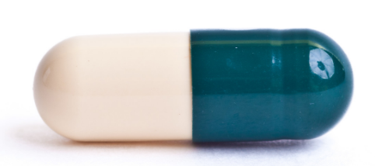
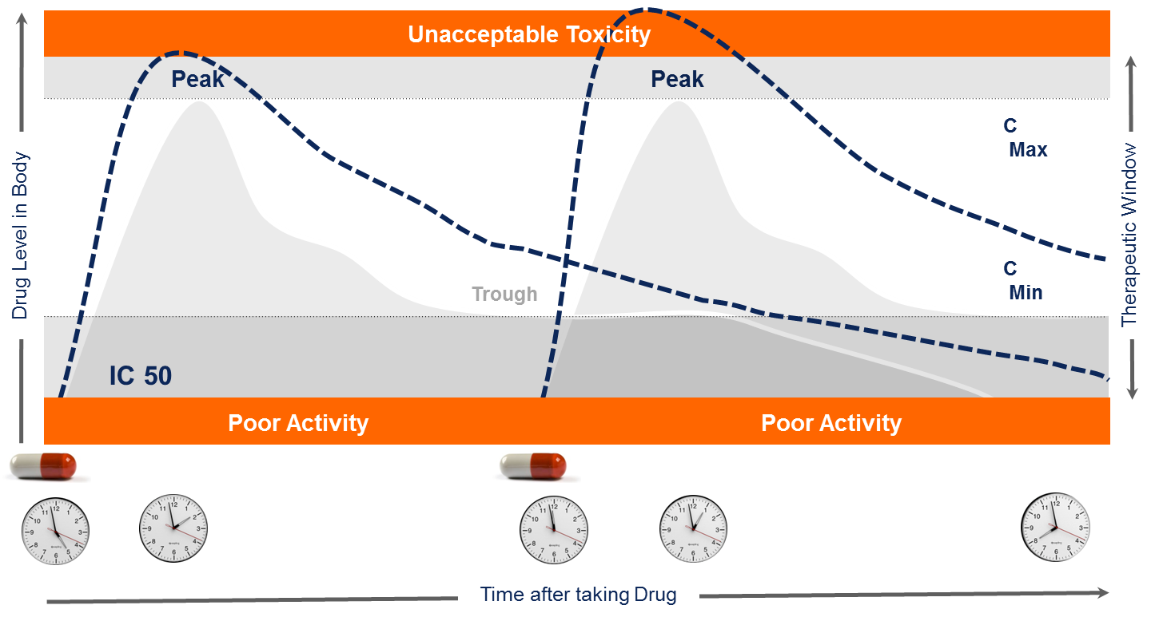
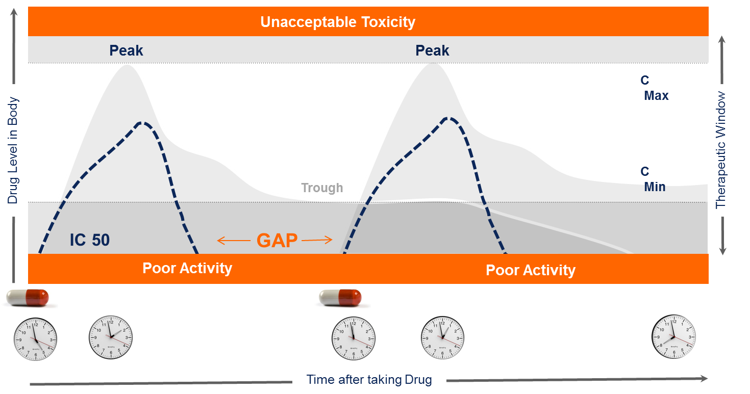
Concomitant drug inhibits CYP-mediated metabolism
Concomitant drug induces CYP-mediated metabolism
X
CYP3A
CYP3A
CYP3A
CYP3A
+
Inactive metabolite
Drug plasma conc.
Inactive metabolite
Drug plasma conc.
+
AUC decreases
AUC increases
E.g., Drug A is metabolised by CYP3A. Drug B inhibits the activity of CYP3A. Drug A is no longer metabolised at the same rate, resulting in accumulation of toxic concentrations.
E.g., Drug A is metabolised by CYP3A. Drug B induces the activity of CYP3A. Drug A is no longer metabolised at the same rate, resulting in lower concentrations and decreased efficacy.
Notes:
When drug metabolism is altered, this area under the curve measurement of concentration over time changes. If the concomitant drug inhibits metabolism of the first drug, concentrations may increase to toxic levels, causing an adverse drug reaction.
If a second drug induces metabolism, then the first drug may be metabolised too quickly resulting in too little of the drug to be effective

Slide 6
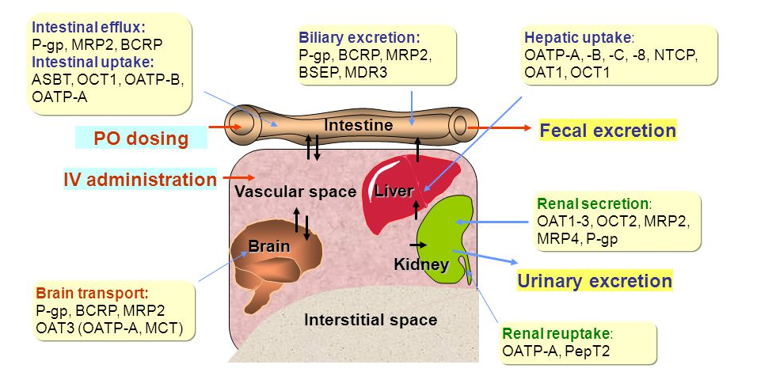
DDIs also occur through inhibition or induction of drug transporters by co-administered drugs
Transporters often work together with
drug metabolizing enzymes in drug
absorption and elimination
They are located in the small intestine,
liver and kidney, which are critical for
drug absorption and elimination
Transporters commonly involved in
DDIs include P-glycoprotein 1/
Multi-drug resistance 1(P-gp/MDR1)
and BCRP (Breast cancer resistance
protein)
The DMPK solution includes comprehensive information for both metabolising enzymes and transporters
Boehringer Ingelheim
http://slideplayer.com/slide/5810493/
Notes:
DDIs also occur via transporters and as I will introduce in the next slide, PharmaPendium’s DMPK solution includes information for both…

Slide 7

DMPK Solution
Supports informed decision-making by providing a more complete picture of potential DDIs for drug candidate risk assessment
Comprehensive data from FDA and EMA Approval packages and literature provides a greater understanding of pharmacokinetic properties of a drug candidate within the context of the complete landscape of approved drugs
Deepest, most detailed information specific for metabolising enzymes and transporters enables greater insight into drug-drug interactions for FDA- and EMA-approved drugs
DDI Risk Calculator (DDIRC)
Fast identification of potential metabolism-based DDIs, informing
critical decisions on which drugs to progress, clinical DDI studies
to perform and risk mitigation strategies to follow.
Data can be utilized from the PK and MET modules to calculate
the risk of DDIs between a candidate and marketed drugs
Notes:
There are a number of ways where information in PharmaPendium supports drug drug interaction prediction and assessment. A key way is through our DMPK solution, which includes PK, MET data and a DDIRC.
I gave a webinar on the pharmacokinetic information in PP last month and will show you where you can access the slides and recording from that presentation. Today, I’ll focus on MET & DDIRC.
Note that PP also includes a unique way of searching post-market adverse event report data from FAERS and this data can also be analysed to identify potential DDIs that become apparent post-market. If you’d like more information on this, please let me know in the comments section

Slide 8
Notes:
With that I would like to thank you for your attention. I case of quetsions, please do not hesitate to get in touch.

